Slide 1
ELEMENTARY STATISTICS, BLUMAN
TI Calculator - Normal Probability (3 of 3)
© 2019 McGraw-Hill Education. All rights reserved. Authorized only for instructor use in the classroom. No reproduction or further distribution permitted without the prior written consent of McGraw-Hill Education.

Slide 2
Objectives for this PowerPoint
How to use the TI Graphing Calculator to find a probability associated with a normally distributed random variable

Slide 3

Problem
According to Phys.org, the average fuel economy of vehicles in the US in 2015 was 24.8 mpg. Assume that vehicle fuel economy in the US is normally distributed with a standard deviation of 4.6 mpg. Find the probability that a randomly selected vehicle in the US would be rated for fuel economy that is between 15 and 33 mpg.
P(15 < x < 33)
$$z=\frac{x−μ}{σ}=\frac{15−24.8}{4.6}=−2.13$$
$$z=\frac{x−μ}{σ}=\frac{33−24.8}{4.6}=1.78$$

Slide 4
Determine Probability Using the Table
P(-2.13 < z < 1.78)
We have calculated z scores and then using the normal distribution table determined that this probability would be 0.9459.
0.9625 - 0.0166 = 0.9459
Let’s see how the TI graphing calculator can be used to arrive at the same result.

Slide 5
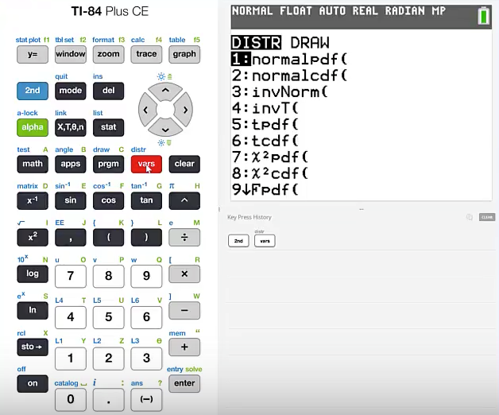
TI Calculator (1)
Press 2nd vars
We are going to use the normalcdf function.
Press 2

Slide 6
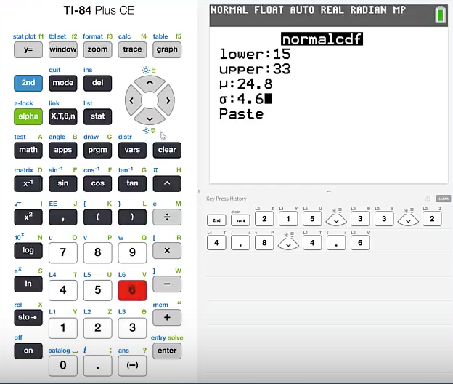
TI Calculator (2)
The lower limit will be 15.
cursor down
The upper limit will be 33.
cursor down
The standard deviation is 4.6.
cursor down
Highlight paste and press enter.

Slide 7
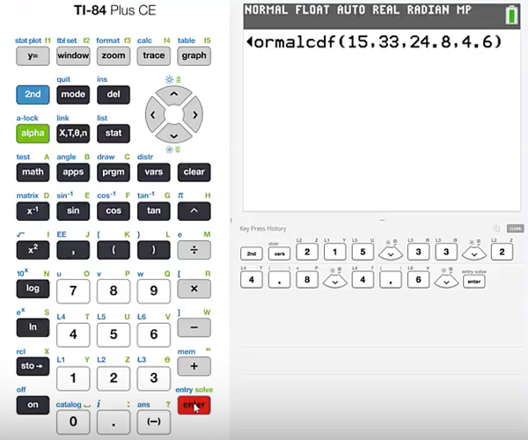
TI Calculator (3)
If you are using a TI graphing calculator that does not present a prompt for entering the required values then you will need to place the values in order. That order will be the lower limit, upper limit, mean, and then standard deviation.
Press enter

Slide 8
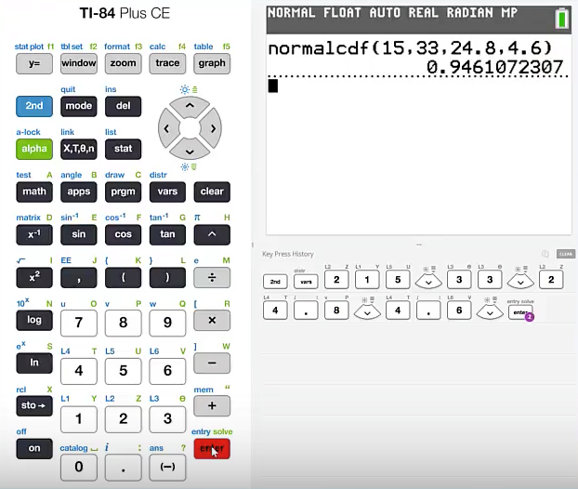
TI Calculator (4)
The calculator has determined that this probability will be 0.946.

Slide 9
Discrepancy
Notice the slight discrepancy in the probability that was calculated using the normal distribution table and the probability that was returned by the TI graphing calculator. There is a difference of two ten thousandths. This is due to the rounding that occurs in the z scores and the four decimal place rounding in the body of the normal distribution table.
The TI graphing calculator utilizes the normal distribution formula and can therefore carry accuracy to a greater degree.

Slide 10
Summary
In this PowerPoint, we learned How to use the TI Graphing Calculator to find a probability associated with a normally distributed random variable.

